Slide 1


Slide 2

ABOUT US
BANK ANALYTICS
GROUP 6
1. Mr. Rutik Sudhir Throat
2. Mr. Nithej N
3. Mr. Dinesh Katyaya Avanigadda
4. Mr. Aryan Magdum
5. Mr. Karthick
6. Mr. Himanshu Mukunda Baviskar
7. Mr. Nithin D.M

Slide 3
INTRODUCTION
Welcome everyone,
Today, I am excited to present our bank analytics project, leveraging the power of Excel, Power BI, Tableau, and SQL to unlock valuable insights and drive informed decision-making within our banking operations. This project utilizes two datasets “Finance 1” and “Finance 2” each providing unique perspectives and analysis facilities performance.
DATASETS OVERVIEW :
Finance 1
This datasets provides a detailed overview of bank analysis, encompassing crititcal information such as id , membered , loan amount , funded amount and etc stuffs .
Finance 2
This supplementary datasets adds depth to the analysis by banking information such as dealing_yrs , earliest_cr_line, inq_last_6 months and etc time duration things indicated to finance 1.

Slide 4




TOOLS USED :
Excel: Serving as the cornerstone of our analytics toolkit, Excel facilitates data manipulation, cleansing, and basic analysis, providing us with a solid foundation for further exploration.
Power BI: With its intuitive interface and robust data visualization capabilities, Power BI enables us to create interactive dashboards and reports, offering a dynamic lens through which we can delve into our data and extract actionable insights.
SQL (Structured Query Language): As the backbone of our data infrastructure, SQL enables efficient data storage, retrieval, and manipulation, ensuring that we can seamlessly access and analyze vast datasets to extract meaningful insights.
Tableau: Building upon the strengths of Power BI, Tableau empowers us to craft compelling visual narratives, uncovering patterns, trends, and outliers that may have otherwise remained hidden, thus facilitating more informed decision-making across all levels of our organization.

Slide 5
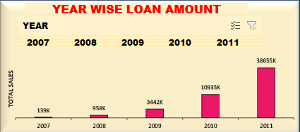
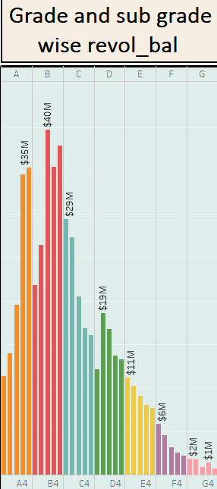
Year-wise Loan Amount Stats:
Evaluate the overall growth or decline in loan amounts over the years.
Identify any notable spikes or dips and explore the factors contributing to these trends.
Discuss the implications of these trends on the bank's overall financial health.
INTRODUCTION ABOUT KPIS :
Year-wise Loan Amount Stats:
Evaluate the overall growth or decline in loan amounts over the years.
Identify any notable spikes or dips and explore the factors contributing to these trends.
Discuss the implications of these trends on the bank's overall financial health
Grade and Subgrade-wise Revol_Bal:
Break down the revolving balances based on borrower grades and subgrades.
Examine how different credit categories impact the amount borrowers have yet to pay.
Highlight any patterns or disparities in revolving balances among various borrower groups

Slide 6
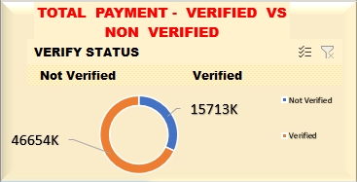
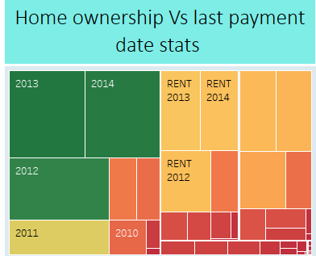
Total Payment for Verified Vs Non-Verified Status:
Compare the total payments made by borrowers with verified information against those without.
Explore whether verified status correlates with more consistent and timely payments.
Discuss potential insights into the reliability and financial stability of borrowers based on verification status.
Home Ownership Vs Last Payment Date Stats:
Investigate how home ownership relates to the timing of the last payment.
Explore whether homeowners tend to make payments earlier or later than non-homeowners.
Discuss the potential impact of home ownership on financial responsibility and payment behavior.

Slide 7
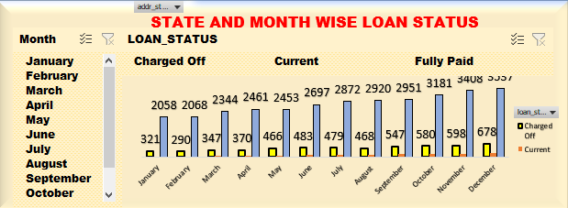
State-wise and Month-wise Loan Status:
Analyze loan statuses across different states to identify regions with higher or lower loan performance.
Examine monthly variations in loan statuses to pinpoint any seasonal trends or patterns.
Discuss potential strategies or interventions based on geographical and temporal insights.

Slide 8
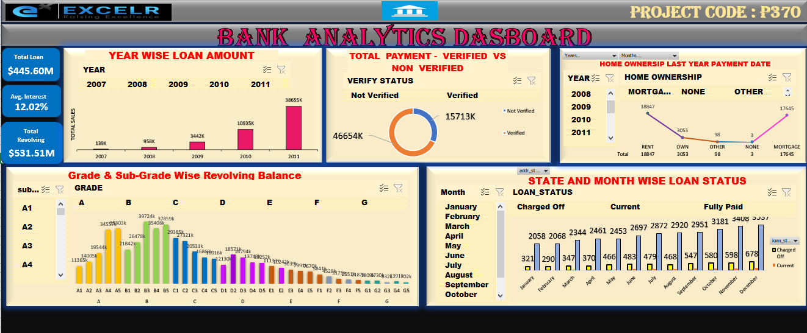
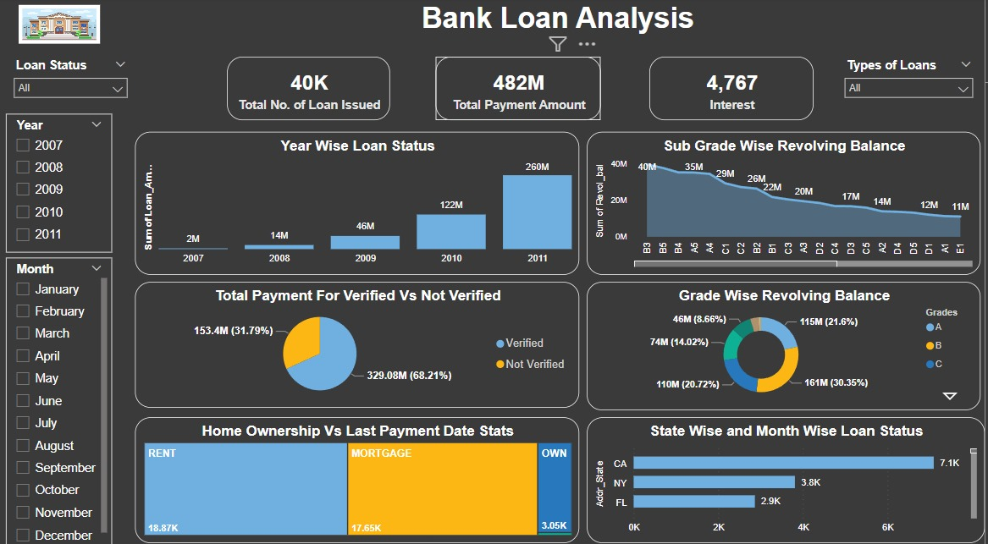
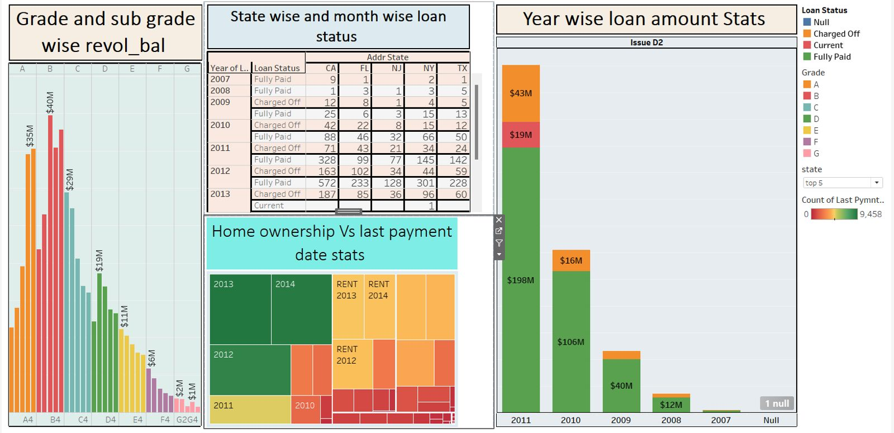
DASHBOARDS :

Slide 9
Challenges Faced :
KPI Definition Complexity:
Defining Key Performance Indicators (KPIs) that are both meaningful and easy to understand proved challenging.
Balancing simplicity for users with the need for actionable insights required careful consideration.
Interactive Dashboard Design:
Creating an interactive and user-friendly dashboard posed challenges.
Striking the right balance between providing comprehensive information and keeping the dashboard easy to use demanded iterative design and testing.
Handling Large Data Sets:
Dealing with a large amount of data presented performance challenges.
Optimizing the project to efficiently handle sizable datasets required fine-tuning and optimization.
User Training and Adoption:
Introducing the Power BI project to users and ensuring they adopt it presented challenges.
Overcoming resistance to change and providing effective training for users to use the dashboard required strategic communication and support.

Slide 10
CONCLUSION :
In conclusion, our bank analysis project demonstrated the transformative power of analytics in driving strategic decision-making and performance improvement within the banking sector. By leveraging Excel, Power BI, MySQL, and Tableau, we extracted actionable insights across key focus areas including State-wise and Month-wise Loan Status , Home Ownership Vs Last Payment Date Stats, Total Payment for Verified Vs Non-Verified Status, Grade and Subgrade-wise Revol_Bal, Year-wise Loan Amount Stats .

Slide 11


